Slide 1

Clustering II
Dr. Faisal Kamiran
DR. FAISAL KAMIRAN
INFORMATION TECHNOLOGY UNIVERSITY

Slide 2
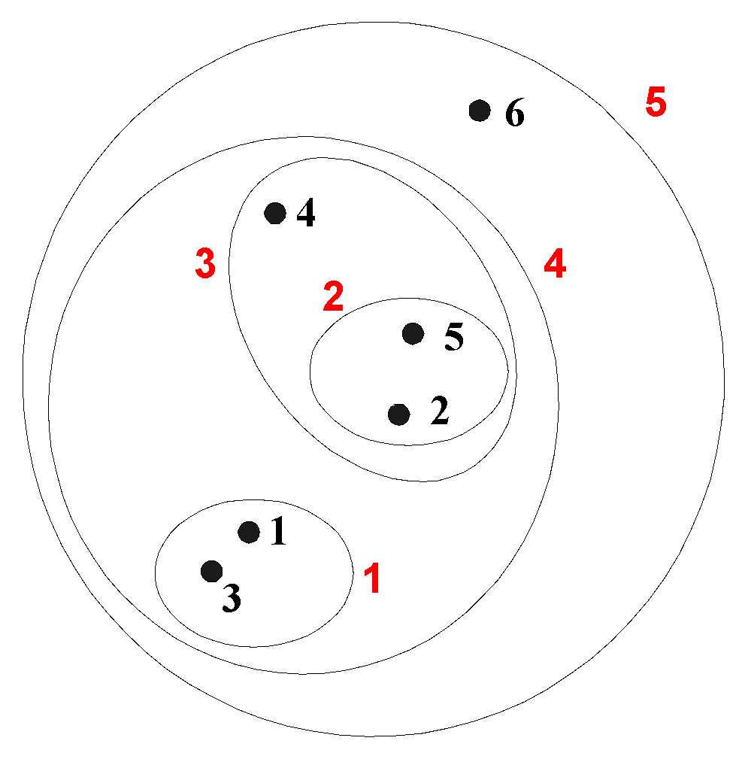
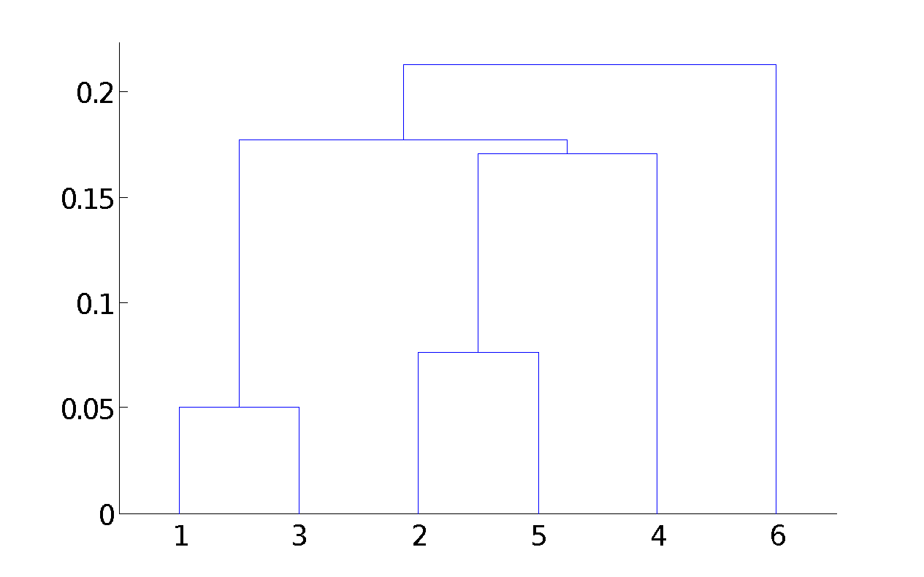
Hierarchical Clustering
Produces a set of nested clusters organized as a hierarchical tree
Can be visualized as a dendrogram
A tree like diagram that records the sequences of merges or splits

Slide 3
Strengths of Hierarchical Clustering
Do not have to assume any particular number of clusters
Any desired number of clusters can be obtained by ‘cutting’ the dendogram at the proper level
They may correspond to meaningful taxonomies
Example in biological sciences (e.g., animal kingdom, phylogeny reconstruction, …)

Slide 4
Hierarchical Clustering
Two main types of hierarchical clustering
Agglomerative:
Start with the points as individual clusters
At each step, merge the closest pair of clusters until only one cluster (or k clusters) left
Divisive:
Start with one, all-inclusive cluster
At each step, split a cluster until each cluster contains a point (or there are k clusters)
Traditional hierarchical algorithms use a similarity or distance matrix
Merge or split one cluster at a time

Slide 5
Agglomerative Clustering Algorithm
More popular hierarchical clustering technique
Basic algorithm is straightforward
Compute the proximity matrix
Let each data point be a cluster
Repeat
Merge the two closest clusters
Update the proximity matrix
Until only a single cluster remains
Key operation is the computation of the proximity of two clusters
Different approaches to defining the distance between clusters distinguish the different algorithms

Slide 6
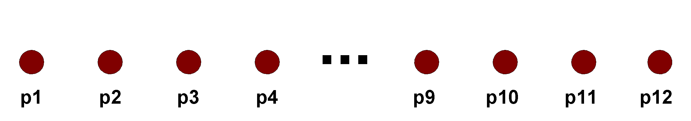
Starting Situation
Start with clusters of individual points and a proximity matrix
p1
p2
p3
p4
p5
. . .
p1
p2
p3
p4
p5
.
.
.
Proximity Matrix

Slide 7
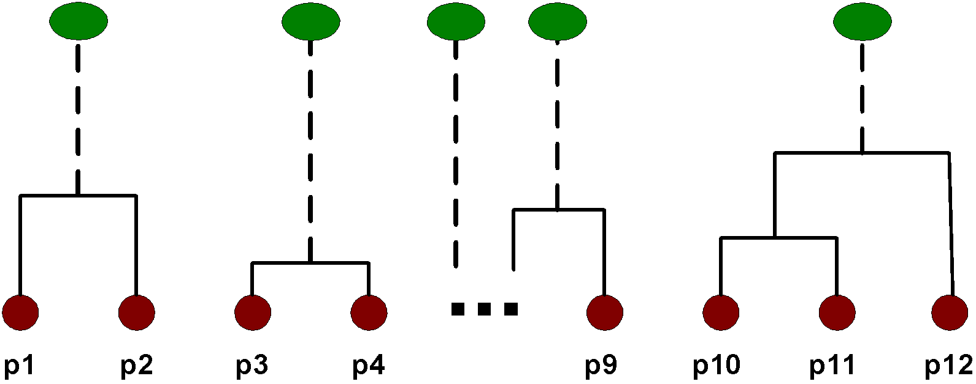
Intermediate Situation
After some merging steps, we have some clusters
C1
C2
C3
C4
C5
C1
C2
C3
C3
C4
C4
C5
Proximity Matrix
C1
C2
C5

Slide 8
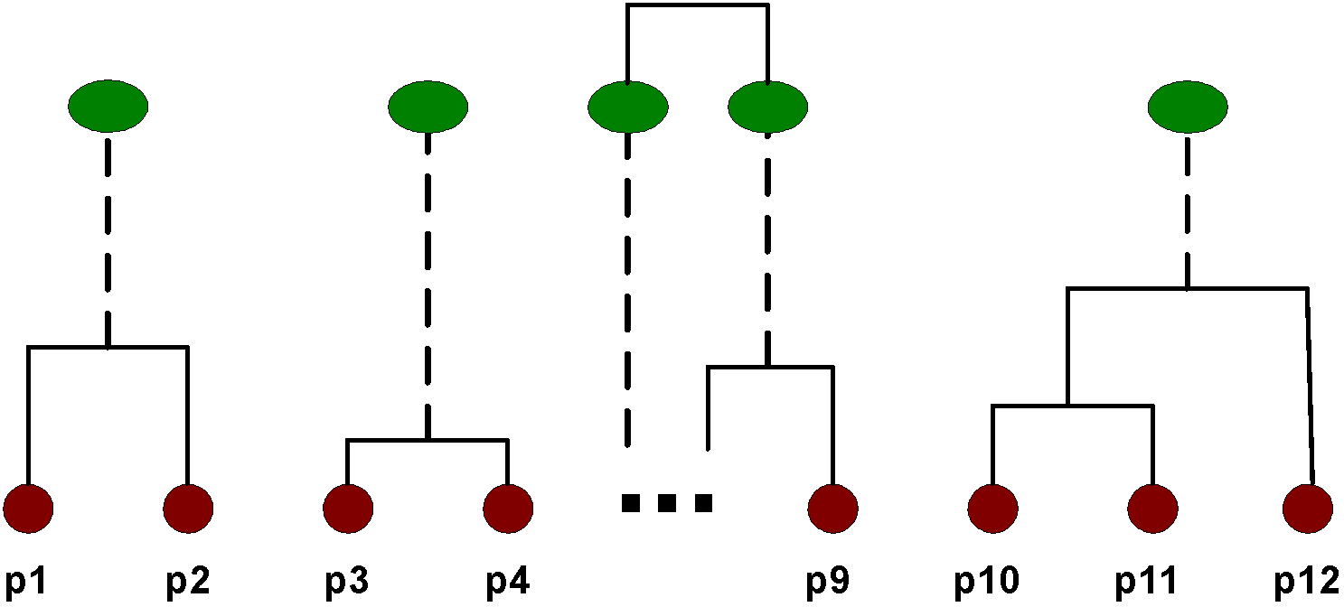
Intermediate Situation
We want to merge the two closest clusters (C2 and C5) and update the proximity matrix.
C1
C2
C3
C4
C5
C1
C2
C3
C3
C4
C4
C5
Proximity Matrix
C1
C2
C5

Slide 9
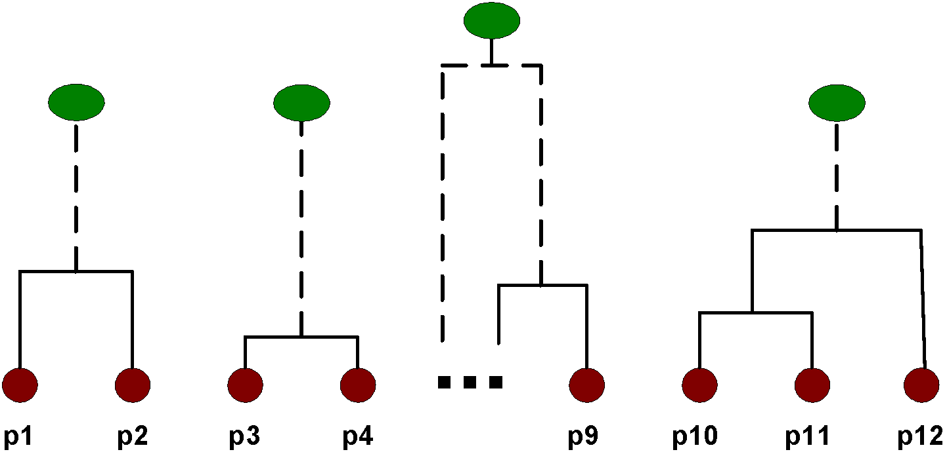
After Merging
The question is “How do we update the proximity matrix?”
C2 U C5
C1
C3
C4
C1
?
C2 U C5
? ? ? ?
C3
C3
?
C4
C4
?
Proximity Matrix
C1
C2 U C5

Slide 10
How to Define Inter-Cluster Similarity
p1
p2
p3
p4
p5
. . .
p1
Similarity?
p2
p3
p4
p5
MIN
MAX
Group Average
Distance Between Centroids
Other methods driven by an objective function
Ward’s Method uses squared error
.
.
.
Proximity Matrix

Slide 11
How to Define Inter-Cluster Similarity
p1
p2
p3
p4
p5
. . .
p1
p2
p3
p4
p5
MIN
MAX
Group Average
Distance Between Centroids
Other methods driven by an objective function
Ward’s Method uses squared error
.
.
.
Proximity Matrix

Slide 12
How to Define Inter-Cluster Similarity
p1
p2
p3
p4
p5
. . .
p1
p2
p3
p4
p5
MIN
MAX
Group Average
Distance Between Centroids
Other methods driven by an objective function
Ward’s Method uses squared error
.
.
.
Proximity Matrix

Slide 13
How to Define Inter-Cluster Similarity
p1
p2
p3
p4
p5
. . .
p1
p2
p3
p4
p5
MIN
MAX
Group Average
Distance Between Centroids
Other methods driven by an objective function
Ward’s Method uses squared error
.
.
.
Proximity Matrix

Slide 14
How to Define Inter-Cluster Similarity
p1
p2
p3
p4
p5
. . .
p1
×
×
p2
p3
p4
p5
MIN
MAX
Group Average
Distance Between Centroids
Other methods driven by an objective function
Ward’s Method uses squared error
.
.
.
Proximity Matrix

Slide 15
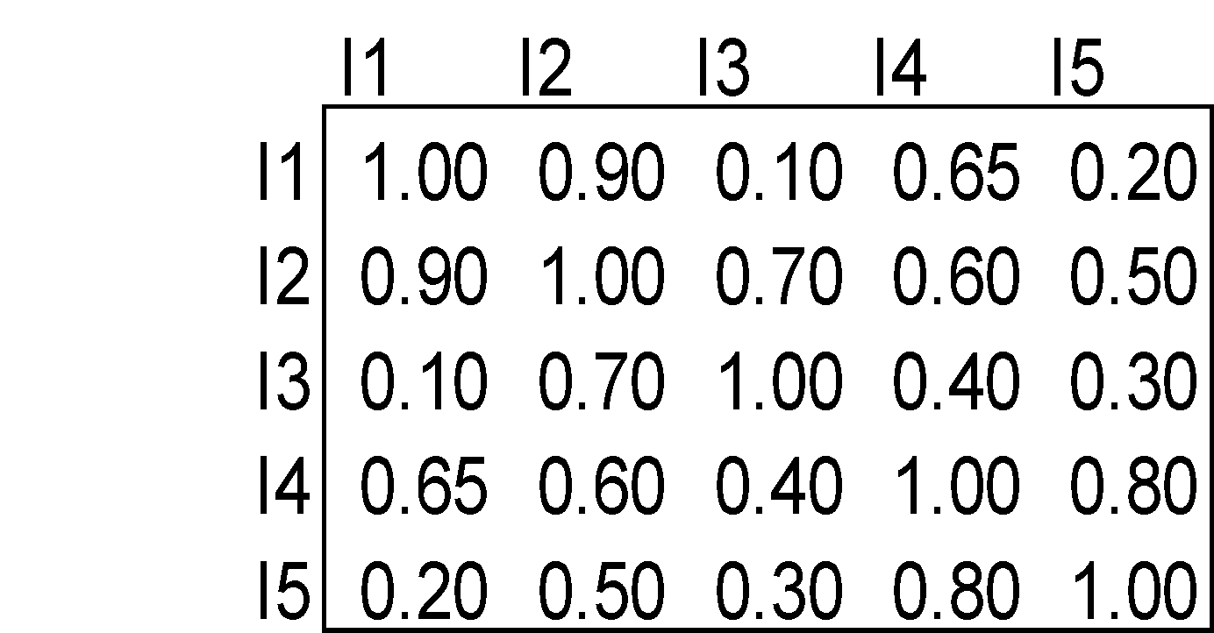
Cluster Similarity: MIN or Single Link
Similarity of two clusters is based on the two most similar (closest) points in the different clusters
Determined by one pair of points, i.e., by one link in the proximity graph.
1
2
3
4
5

Slide 16
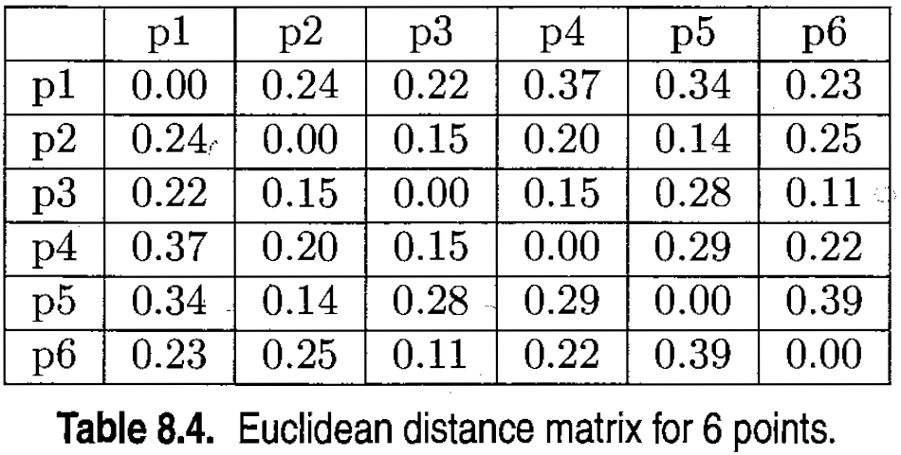
Cluster Similarity: MIN or Single Link

Slide 17
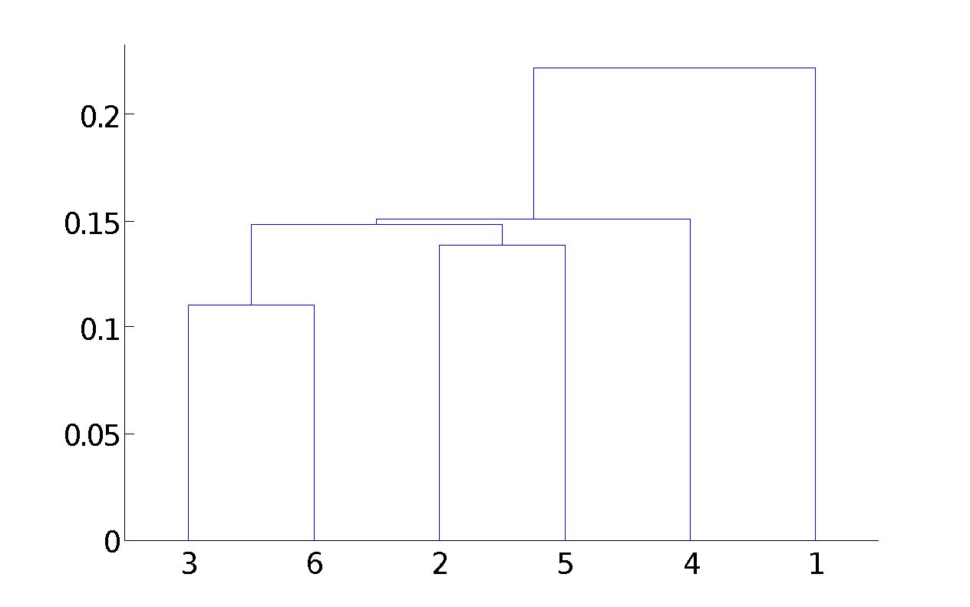
Hierarchical Clustering: MIN
5
1
3
5
2
1
2
3
6
4
4
Nested Clusters
Dendrogram

Slide 18
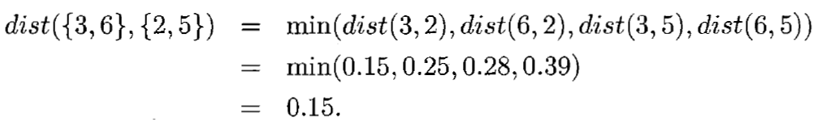
Cluster Similarity: MIN or Single Link

Slide 19
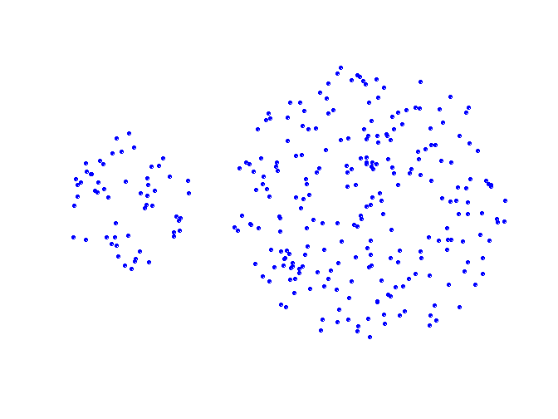
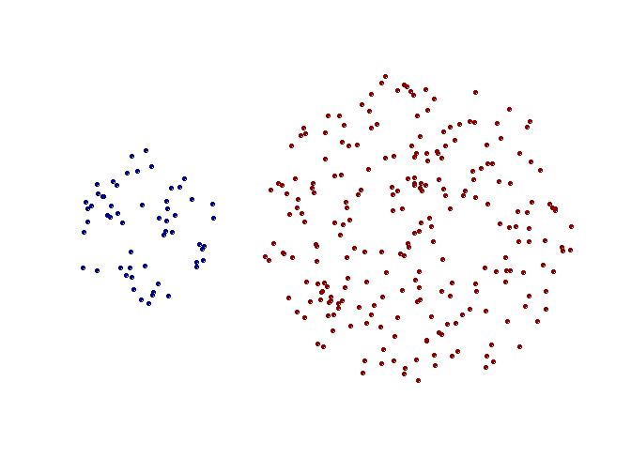
Strength of MIN
Original Points
Two Clusters
Can handle non-elliptical shapes

Slide 20
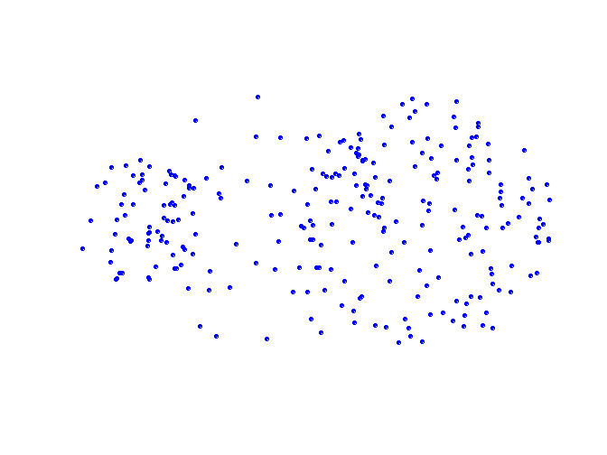
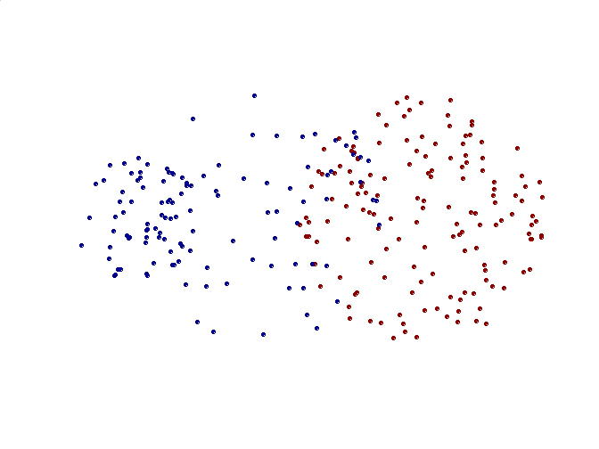
Limitations of MIN
Original Points
Two Clusters
Sensitive to noise and outliers

Slide 21
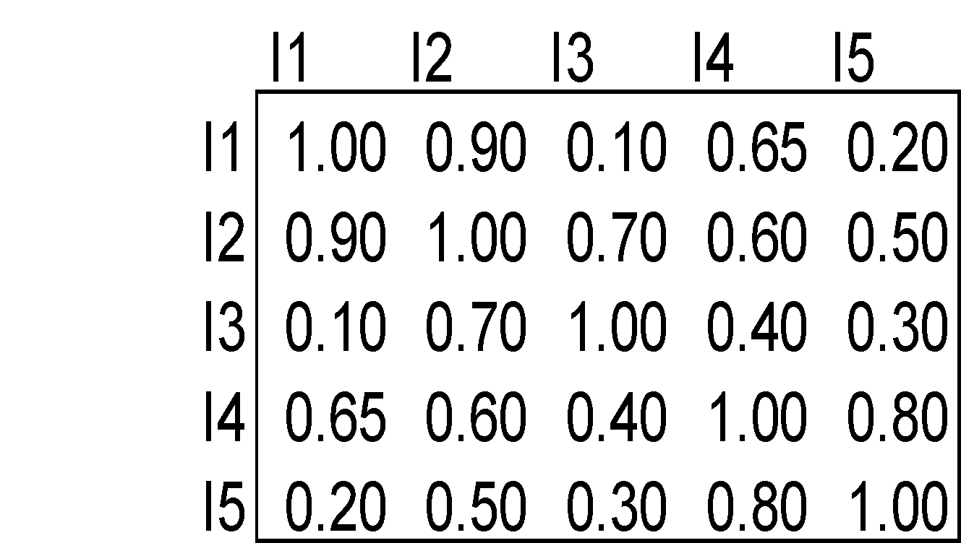
Cluster Similarity: MAX or Complete Linkage
Similarity of two clusters is based on the two least similar (most distant) points in the different clusters
Determined by all pairs of points in the two clusters
1
2
3
4
5

Slide 22
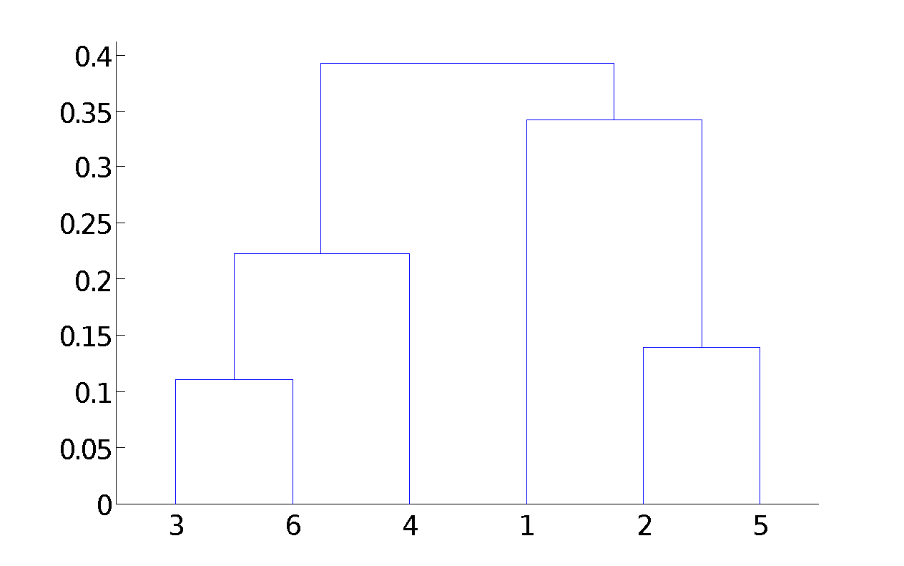
Hierarchical Clustering: MAX
4
1
2
5
5
2
3
6
3
1
4
Nested Clusters
Dendrogram

Slide 23
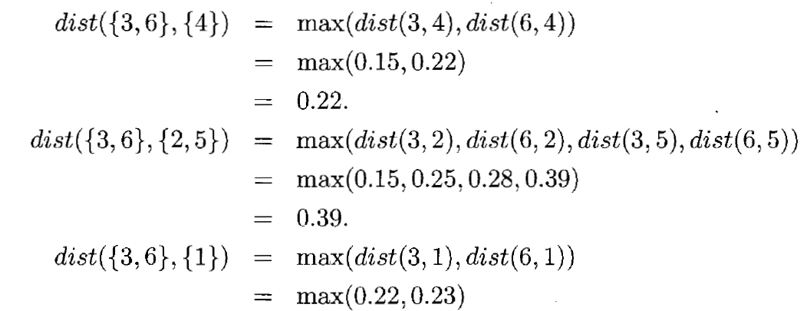
Cluster Similarity: MAX

Slide 24
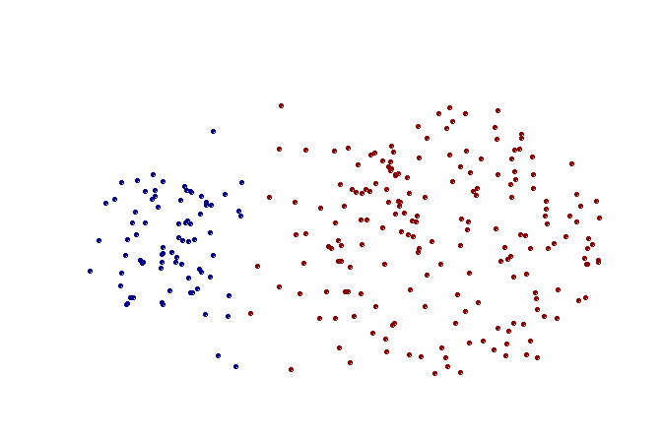
Strength of MAX
Original Points
Two Clusters
Less susceptible to noise and outliers

Slide 25
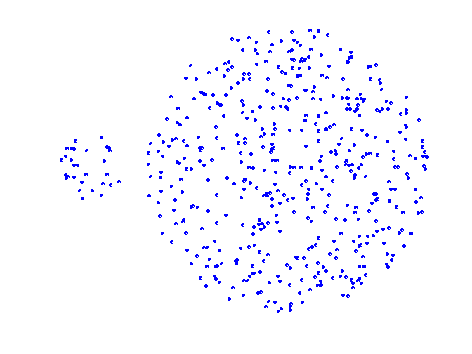
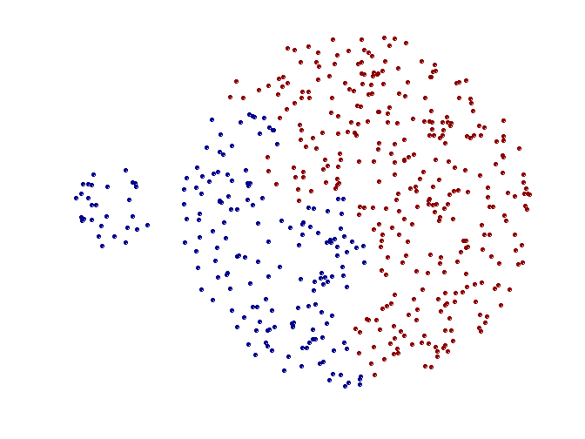
Limitations of MAX
Original Points
Two Clusters
Tends to break large clusters
Biased towards globular clusters

Slide 26
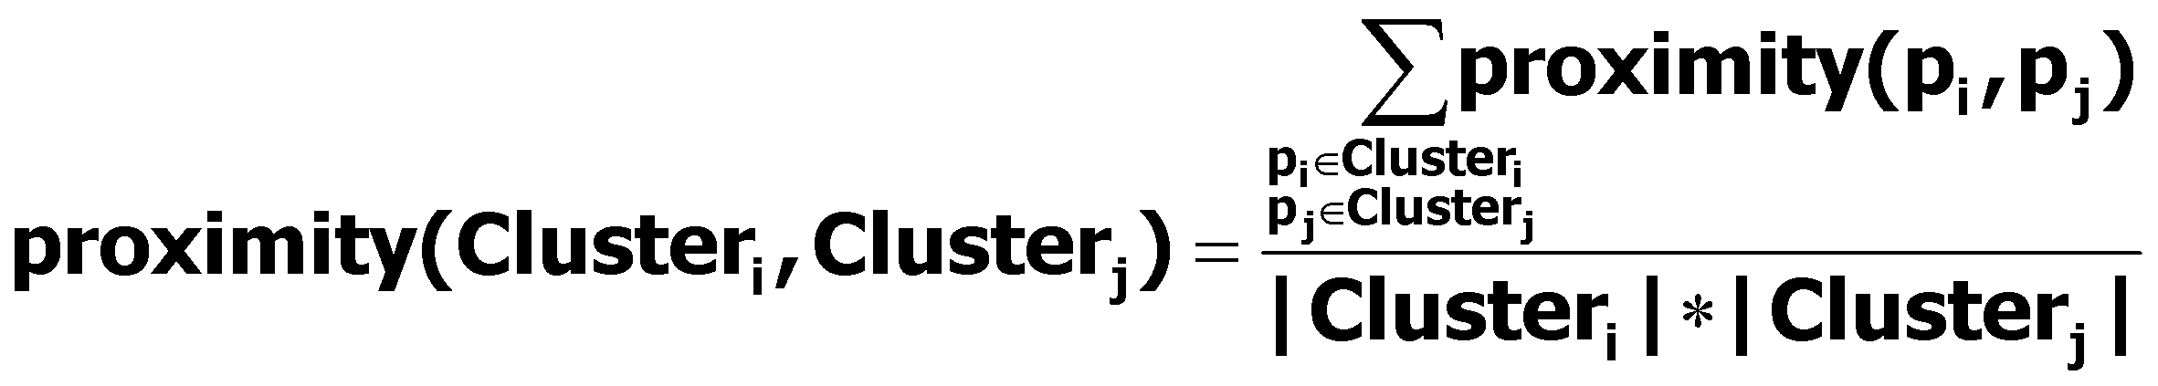
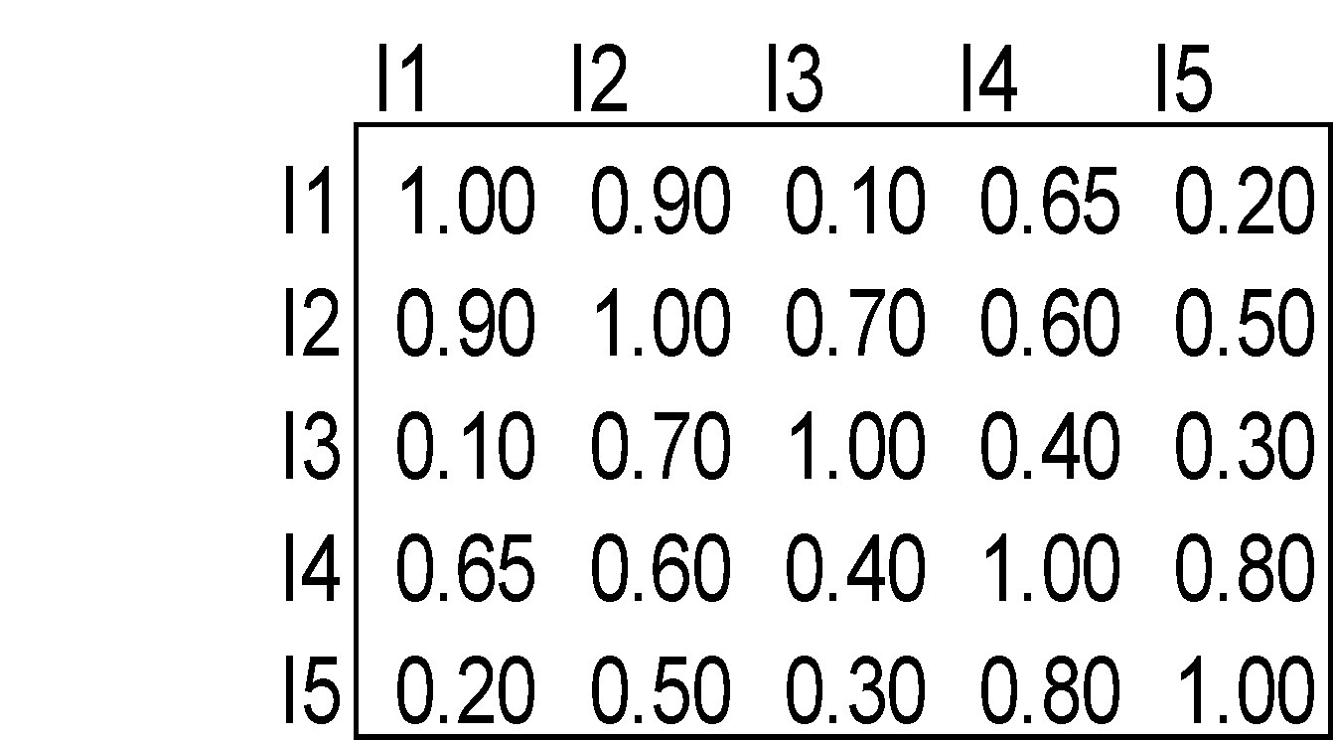
Cluster Similarity: Group Average
Proximity of two clusters is the average of pairwise proximity between points in the two clusters.
Need to use average connectivity for scalability since total proximity favors large clusters
1
2
3
4
5

Slide 27
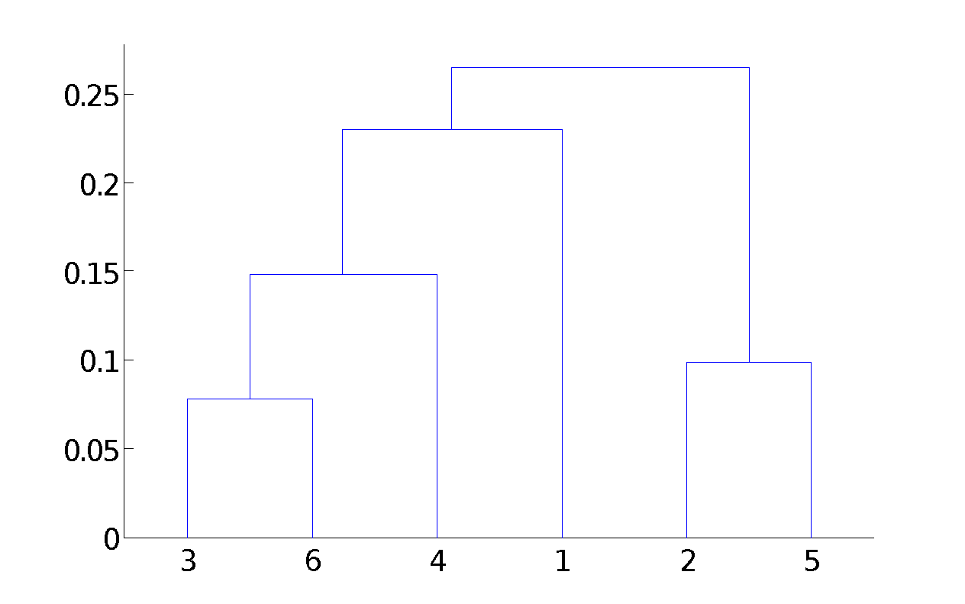
Hierarchical Clustering: Group Average
5
1
4
2
5
2
3
6
1
4
3
Nested Clusters
Dendrogram

Slide 28
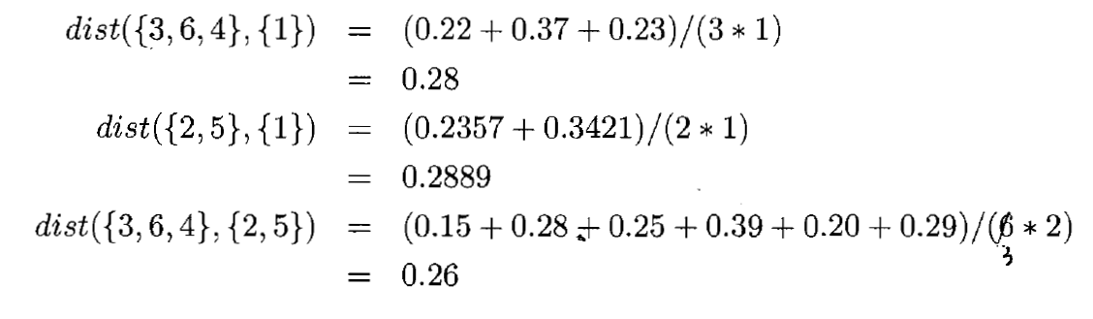
Cluster Similarity: Group Average

Slide 29
Hierarchical Clustering: Group Average
Compromise between Single and Complete Link
Strengths
Less susceptible to noise and outliers
Limitations
Biased towards globular clusters

Slide 30
Cluster Similarity: Ward’s Method
Similarity of two clusters is based on the increase in squared error when two clusters are merged
Similar to group average if distance between points is distance squared
Less susceptible to noise and outliers
Biased towards globular clusters
Hierarchical analogue of K-means
Can be used to initialize K-means

Slide 31
Hierarchical Clustering: Comparison
5
1
4
1
3
2
5
5
5
2
1
MIN
2
MAX
2
3
6
3
3
6
1
4
4
4
5
5
1
4
1
2
2
5
2
Ward’s Method
5
2
3
6
Group Average
3
3
6
4
1
1
4
4
3

Slide 32
Hierarchical Clustering: Time and Space requirements
O(N²) space since it uses the proximity matrix.
N is the number of points.
O(N³) time in many cases
There are N steps and at each step the size, N², proximity matrix must be updated and searched
Complexity can be reduced to O(N² log(N) ) time for some approaches

Slide 33
Hierarchical Clustering: Problems and Limitations
Once a decision is made to combine two clusters, it cannot be undone
No objective function is directly minimized
Different schemes have problems with one or more of the following:
Sensitivity to noise and outliers
Difficulty handling different sized clusters and convex shapes
Breaking large clusters

